Slide 1

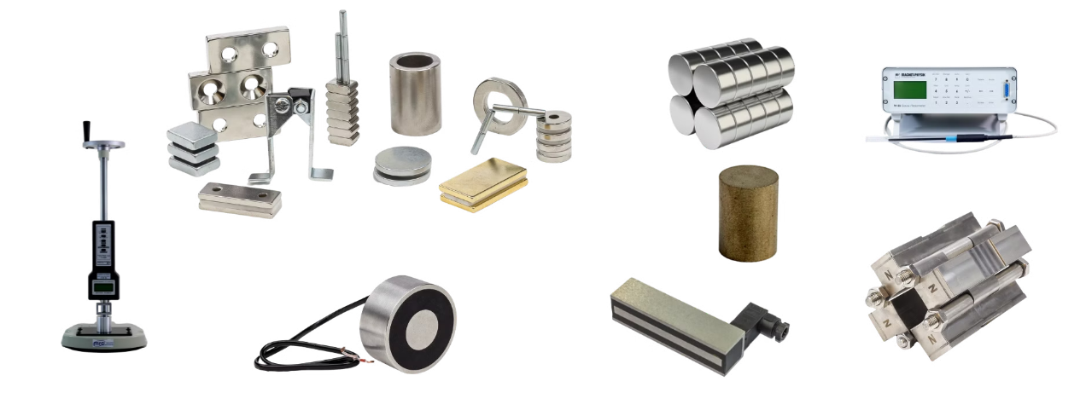
MAGMA MAGNETIC TECHNOLOGIES
Your Partner for all Magnetic Needs

Slide 2

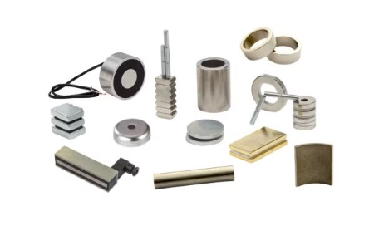
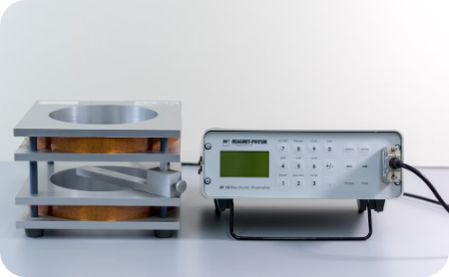

MAGMA: Leaders in Magnetic Solutions
Diverse Magnetic Products
Cutting-Edge Technology
Diverse Applications for all Industries
With over 40 years of expertise, Magma offers a wide range of magnetic products and comprehensive magnetic services. Our portfolio also feature custom-made options tailored to meet your unique requirements.
Combining decades of industry expertise with cutting-edge technology and a state-of-the-art magnetic laboratory, Magma delivers top-notch magnetic solutions for various applications.
As a trusted partner, Magma provides innovative magnetic solutions to meet the unique needs of customers across many different sectors, from biomedical to green energy.

Slide 3

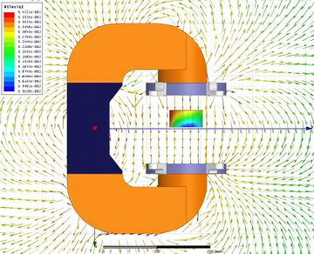
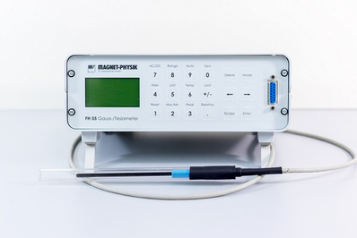

Magnetic Know-How Support
R&D
Support
Simulation
Expertise
Magnetic
Laboratory
Magnetic
Solutions
We support research and development efforts, offering magnetic design, consulting, and FEM analysis services across all industries and applications.
We are Using ANSYS MAXWELL sophisticated software to precisely simulate magnetic behavior and ensure optimal performance.
Our state-of-art lab is equipped with all the necessary magnetic equipment and provides reliable data through extensive testing and measurements.
Our team collaborates closely with clients to create innovative magnetic solutions tailored to their unique needs and challenges.

Slide 4
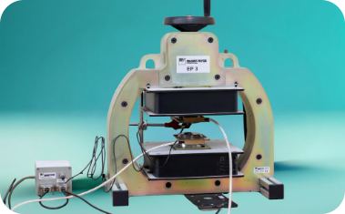
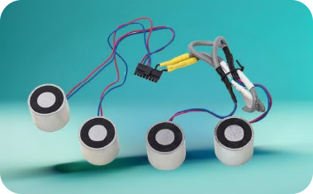
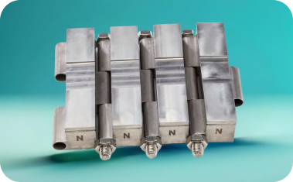
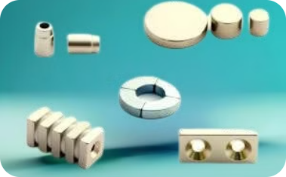
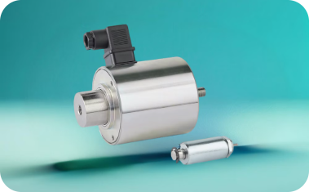
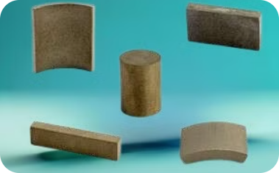
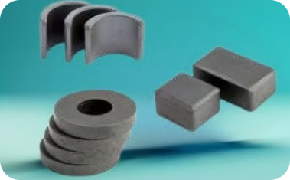

Magma's Magnetic Products
Magnetic Design
Electromagnets
Magnetic Assemblies
Neodymium Magnets
Solenoids
Samarium Cobalt Magnets
Ferrite Magnets
AlNiCo Magnets

Slide 5

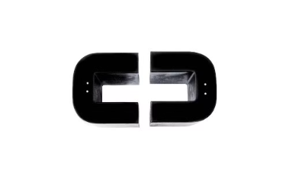

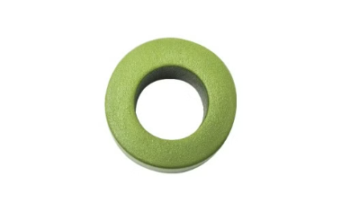
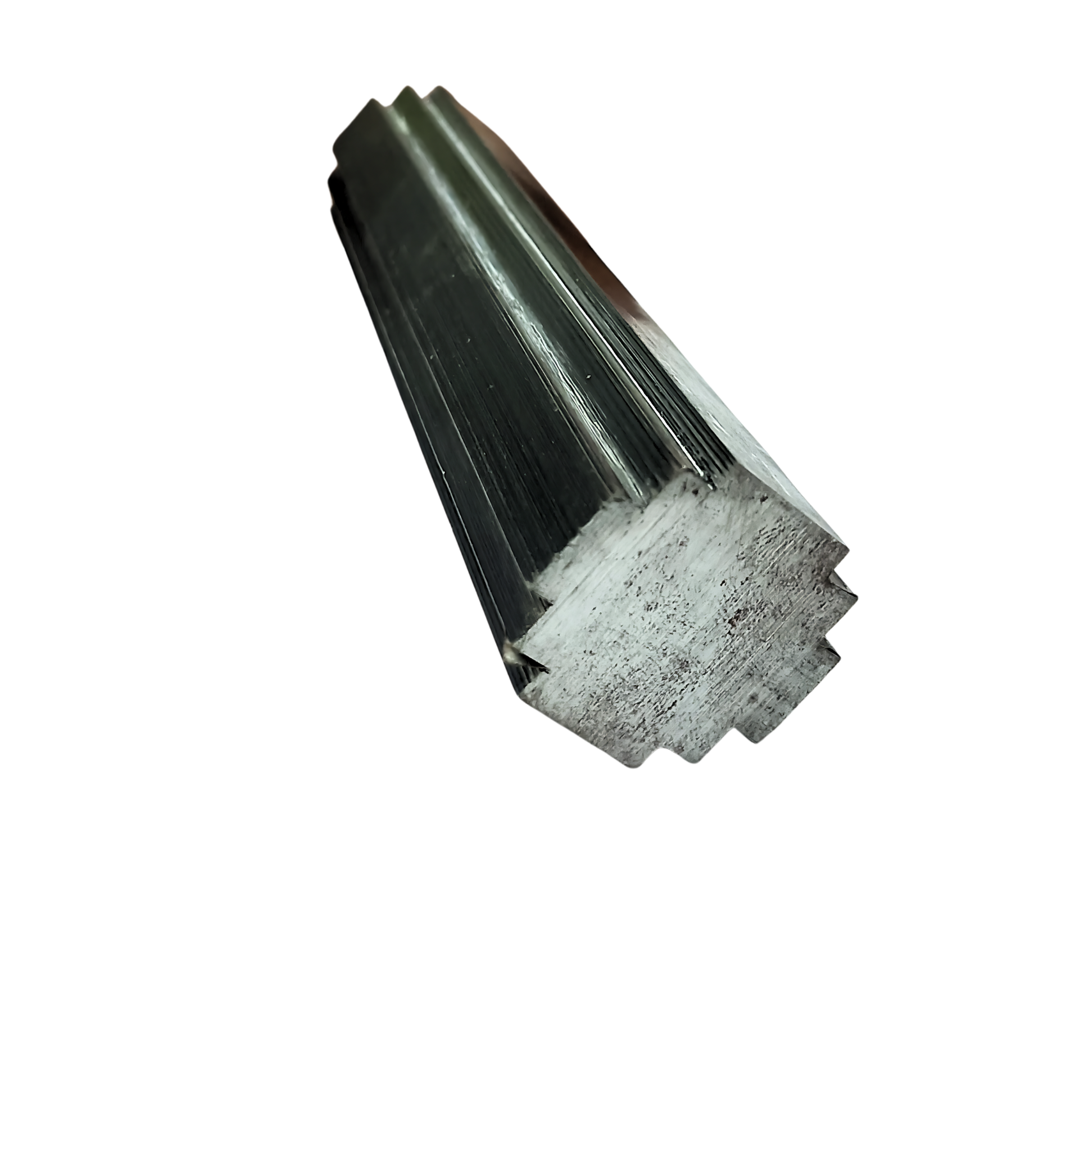
New Line of Products
C-CORES
E-CORES
TOROIDS
SPECIAL CORES
Single-phase wound cut cores
Three-phase wound cut cores
Round-tape wound cores
Special size & shape requirements
Magma has partnered with Eilor Magnetic Cores, which specializes in manufacturing tape-wound magnetic cores. This collaboration enables us to provide production means for highly efficient transformers and inductors tailored to our customers' requirements.

Slide 6
Quality Assurance Control
Magnetic Simulation
We perform precise magnetic simulations to match the right magnet to product specifications, improving magnetic assemblies and Lowering manufacturing costs.
Quality Assurance
Quality control for permanent magnets is crucial to our customer service. Magma ensures high standards with regular, meticulous inspections by both machines and trained professionals.
Customized Solutions
We offer custom-made permanent industrial magnets (all types and grades) and
cutting-edge magnetic solutions on a global scale.
Stable Supply Chain
We maintain a large inventory of magnets, electromagnets, and solenoids to ensure production continuity and provide flexible and fluent supply to our worldwide clients.
Cost Effective
Improving cost-effective processes and products.

Slide 7
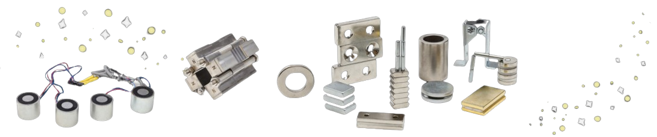
Discover the advantages of magnets
in various applications
Explore how they revolutionize designs and engineering.
Click Here

Slide 8
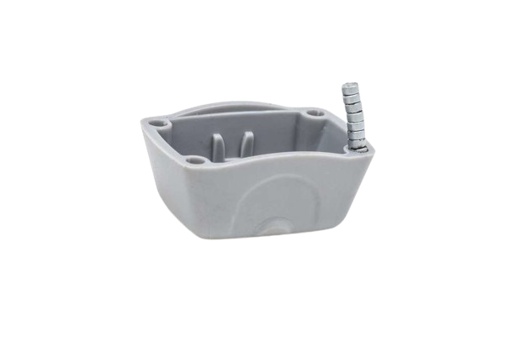
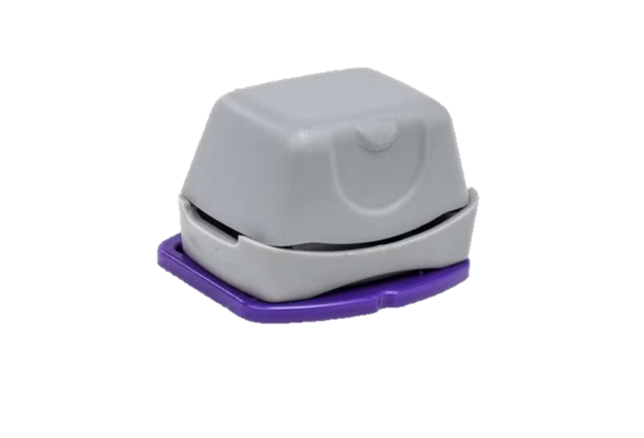
Case Studies:
Biomedical industry
Customer
Challenge
Solution
z
Drug Dispenser Device
Economical assembly of tiny magnets in plastic parts
Developed over-molding process with immediate magnetization

Slide 9
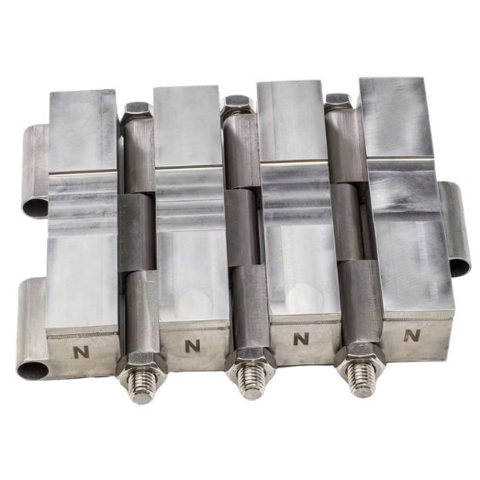
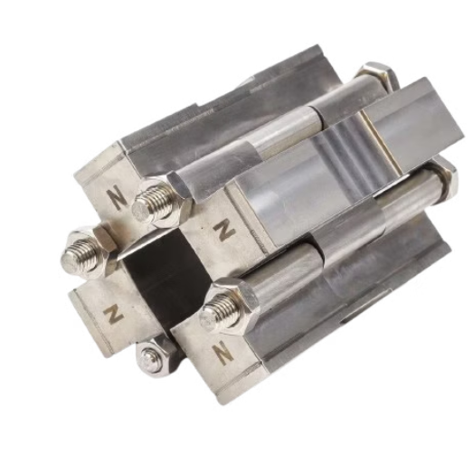
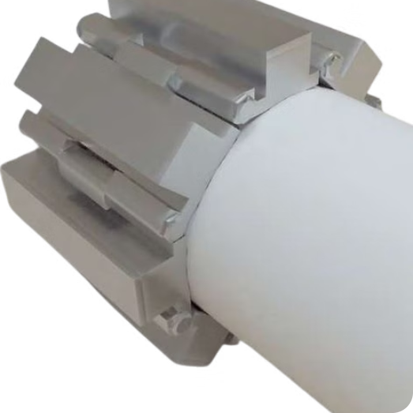
Case Studies:
Sustainable Energy
Challenge
Solution
Avoiding scale in large diameter cooling tower pipes.
Unique magnetic design based on Halbach array for maximal field in 12" assembly, using laser welding.
In this project, Magma became a significant partner of Hydroflux: www.hydroflux.com

Slide 10
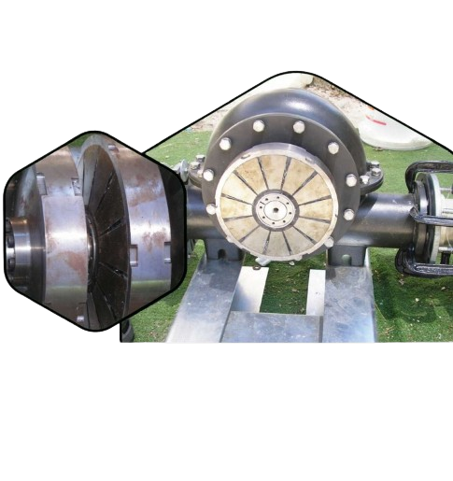
Case Studies:
Green Energy
Challenge
Solution
Low-pressure water flow electricity generation.
Magma developed an efficient magnetic coupling, enabling the successful completion of the product.

Slide 11
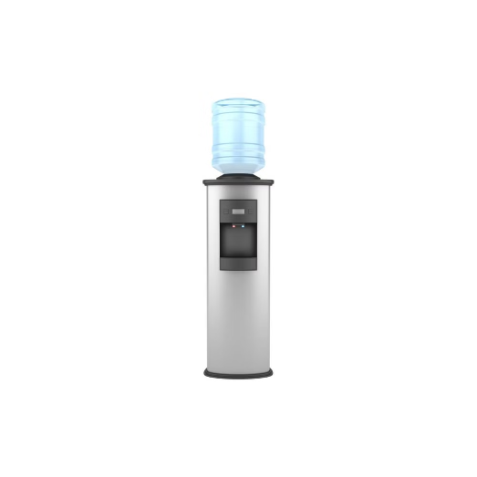
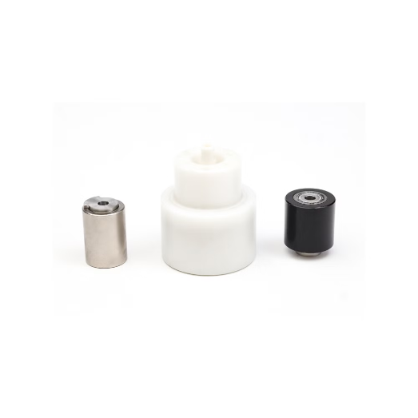
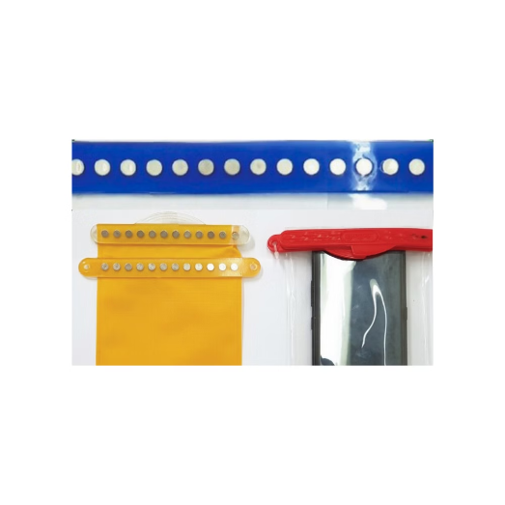
Case Studies:
Home Appliance & Consumer Goods
Water Dispenser
Pool Cleaning Robot
Sealed Pouch
Challenge: Production failure due to plastic and magnetic design deviations. Solution: Rapid two-week solution to prevent production halt, followed by optimization of plastic part and magnet design.
Challenge: Creating mechanical movement in a corrosive environment with minimal energy. Solution: Specific design of magnetic coupling using a radial ring in a plastic cup for corrosion protection.
Challenge: Customer conflict with magnetic product manufacturer. Solution: Set up the entire production line in under three months, improving and reducing the cost of magnetic components.

Slide 12




Looking For A Strategic Partner?
Strategic Collaboration
Magma becomes a significant partner in your projects, offering expertise and innovative solutions.
Innovative Approach
We bring cutting-edge magnetic technology to solve complex challenges across industries.
Comprehensive Support
We offer end-to-end support for all your magnetic needs from design to production.

Slide 13









Contact Magma
Phone
Email
WhatsApp
+972-50-5513013
+972-72-2150592
Gil@magmamagnets.com
Trade@magmamagnets.com
Magma Magnetic Technologies
Visit our website
Online Shop
Magnets Catalog
www.magmamagnets.com
Explore our magnetic products
and services
Explore our wide variety
of magnets
Magma on LinkedIn
Magma on Facebook
News & Updates

